Slide 1
hExSCAPE
From Down2 Developers
Sprint 6: Update()
Review

Slide 2
Sprint 6 Scrum Roles
Scrum Master: Dane Reggia
Product Owner: Billy Loveday
Development Team: Michael Ouille
Gabriel Mayo
Christopher Touchette

Slide 3
Dane’s Sprint 6 Goals
Force the units to move “hexly” since the currently movement is squarely (5)
Only allow movement to a tile that does not current have a piece currently on it and hopefully not tiles that are off the edge of the board (5)
Planning to invest 10 hours toward this goals

Slide 4
Dane’s Sprint 6 Accomplishments
Did the math to move the pieces “hexly”
Made the pieces aware of each other so that it is not allowed to move to an occupied tile
Defined the edges of the board so that navigation out of bounds is not allowed.
Colored the board to look more terrainy and added some background scenery
* All in 8.5 hours of work

Slide 5
Billy’s Goals
To do the most amazing thing he could think of:
Finalize the intro animation
Work on Town Assets and world objects
Work with game board creation
Time expectation: 12 hours

Slide 6
Billy’s Accomplishments
Resolved several issues with Blender animation for the introduction
Completed the introduction... to be displayed in classroom theaters soon (April 30th). See Dane for ticket sales.
Developed pseudocode for how the gameboard information can be saved / reloaded

Slide 7
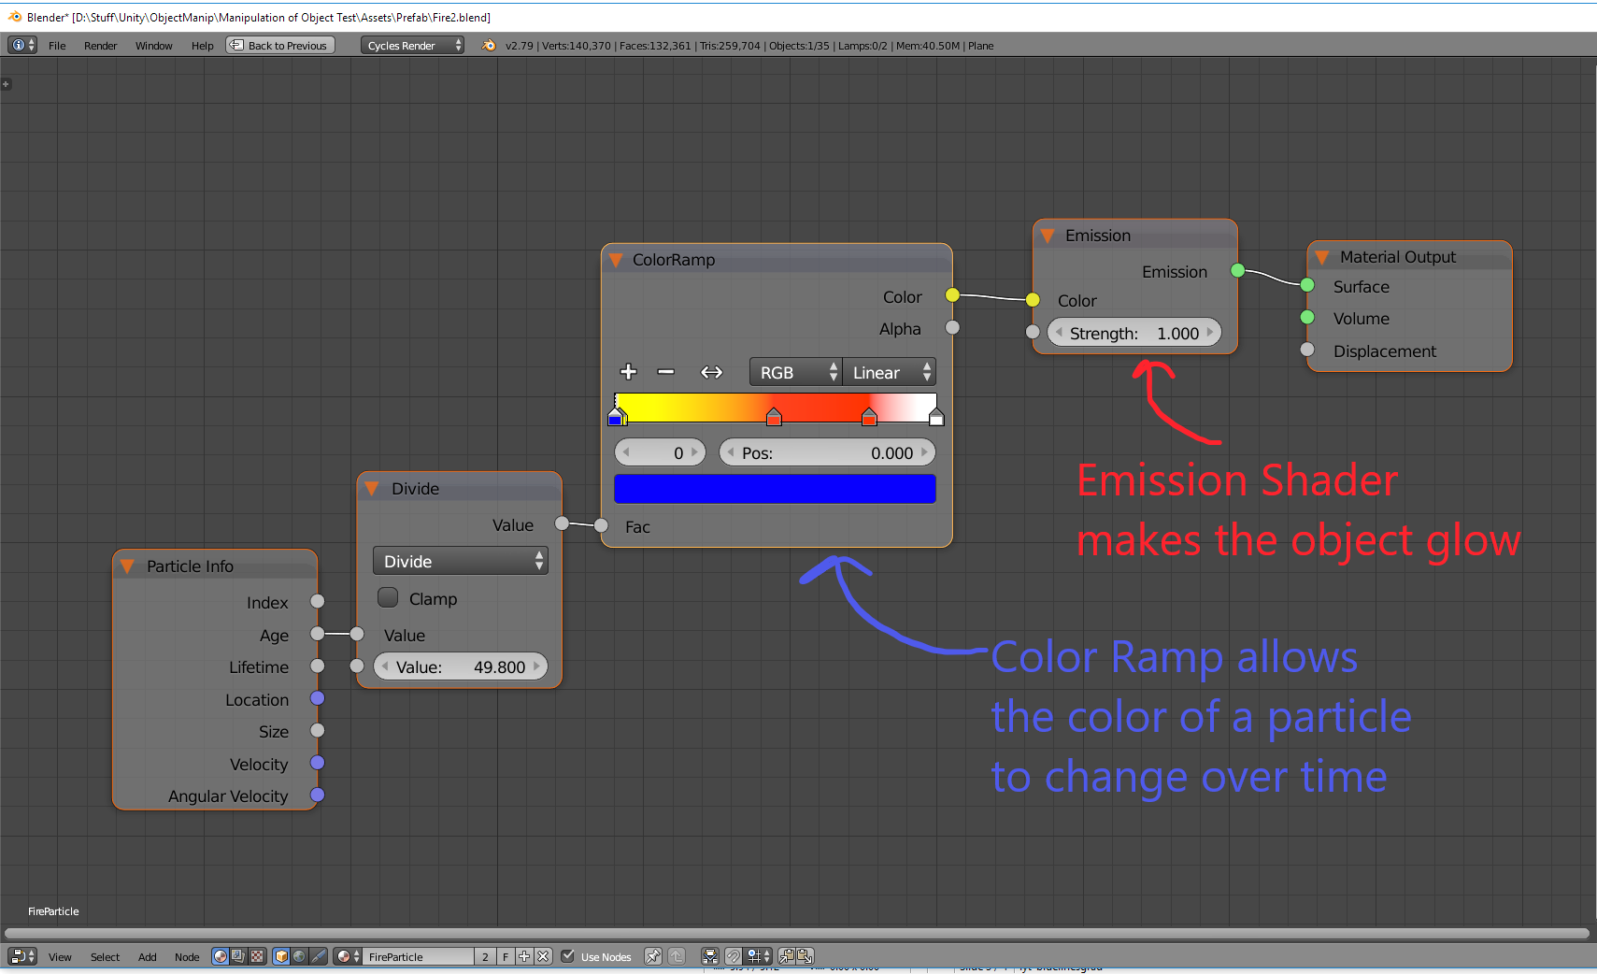
Billy’s Learnings

Slide 8
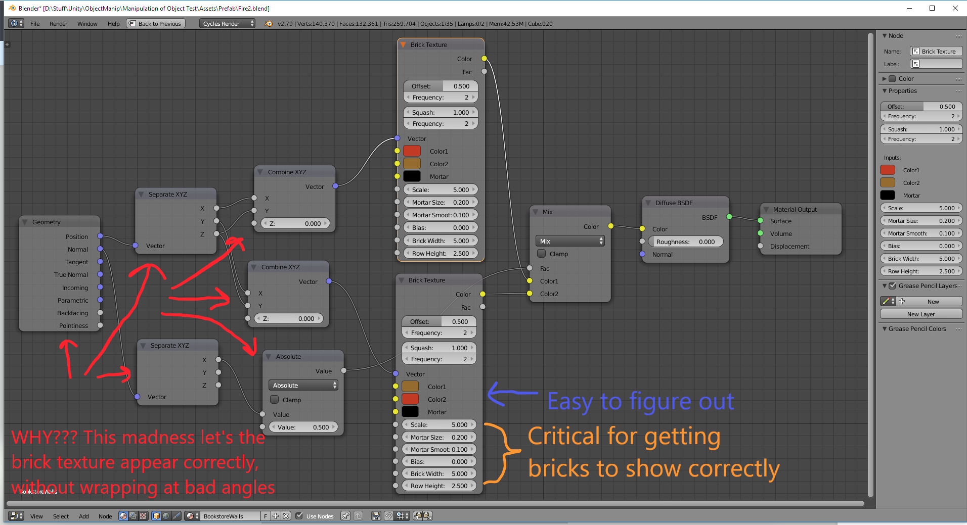
More Learnings

Slide 9
More of Billy’s Accomplishments
Time spent: Way. Too. Much.
Close to 26 hours, including time to compile animations, then lament them not looking as good as I wanted (scene too dim, scene to bright, backwards body on a creature, etc.)
Not feeling good. Look for answers to questions on the class slack channel.

Slide 10
Michael’s Goals/Accomplishments
Goals:
My goal this sprint was to finish up the user profile creation for the main menu and to create some assets for the HUD.
* I committed about 6 hours to this task.
Accomplishments:
I worked about 5 hours this week on this task.
I had a major setback on the user profile creation which will result in rewriting a large section of code.
The HUD assets are finished and mapped out.

Slide 11
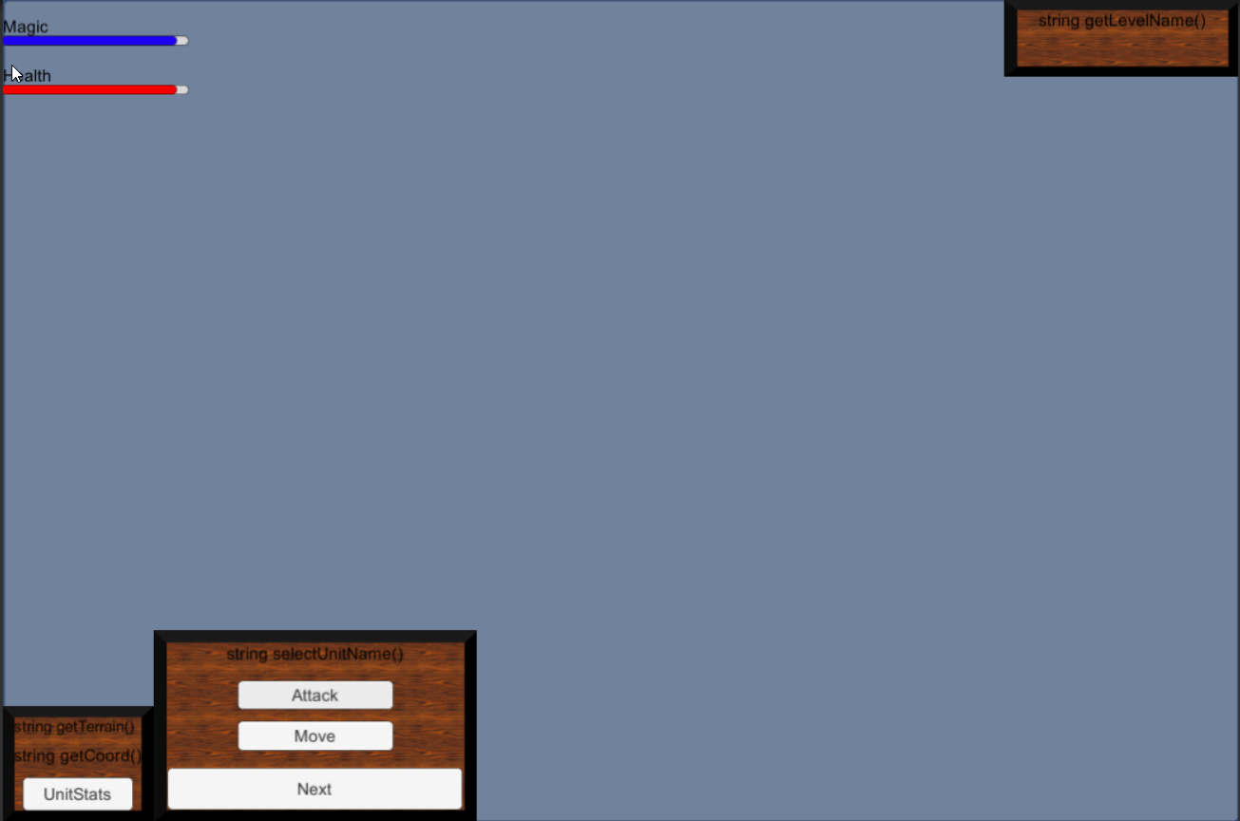
In-Game HUD Display

Slide 12
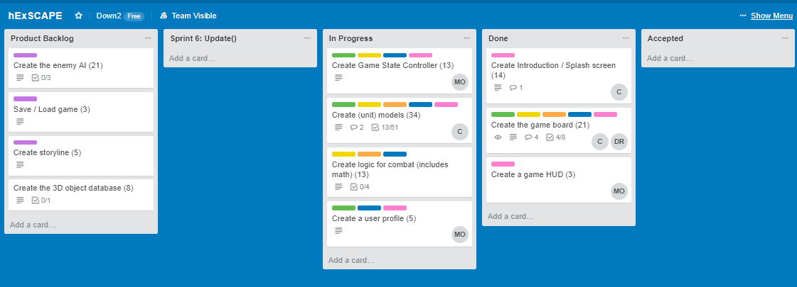
Current Snapshot of Backlog

